Slide 1
Effect of Process Variables on Current Efficiency and
Metal Composition
Master’s Thesis in Electrochemical Engineering
Author:
Håkon Ulvik
Defence date:
06.07.2026
Supervisor: Co-Supervisors:
Dr. Braulio Beltran-Pitarch (NTNU) Assoc. Prof. Espen Sandnes (NTNU) & Dr. Gøril Jahrsengene (SINTEF)

Slide 2
Background and Motivation
Steel is fundamental for modern society
Manganese (Mn) is the third most common alloying element in steel
Most Mn is in the form of ferromanganese (FeMn)
Submerged Arc Furnaces (SAF)
Boston Metal and MIT have developed MOE for Fe

Slide 3
Objective
Expand our knowledge about which variables affect the current efficiency & metal composition

Slide 4
Theoretical Framework
Basicity
  Quantifiable number that is related to melt properties
  Metallurgical: weight fractions, melt behaviour
  Optical: molar fractions, corrosivity of melt against refractory materials
Current Efficiency
  How much of the charge goes into the desired reactions
  Want this to be as close to 100% as possible
  Hall-Heroult: 95%

Slide 5

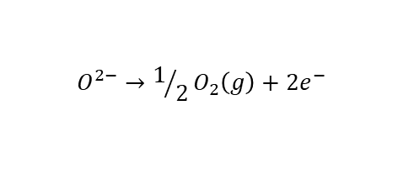

Experimental - Setup
Closed vertical tube furnace
Galvanostatic electrolysis
Spark Plasma Sintering (SPS)
Characterised with SEM-EDS
Gas out
Alumina radiation shields
B-type thermocouple
O₂ gas bubbles
Anode
Fe
Consumable iron cathode
$${Mn}^{2+}+2e^{−}→Mn(l)$$
Tungsten (W) Quasi-Reference
Inert anode (SPS Cr₉₀Fe₁₀)
$$O^{2−}→1/2O_{2}\left(g\right)+2e^{−}$$
Alumina crucibles
Melt
$$FeMn(l)$$
Gas in

Slide 6
Conclusions from Specialisation project
Successful electrolysis using MOE and oxygen evolving electrode, producing a FeMn alloy when only MnO is present was demonstrated
Higher Mn valency leads to drastic reduction in CE
Excessive oxygen production from higher valences might reduce CE because of re-oxidation.
High reactivity of higher valences, more oxides along the crucible walls.
Melts with only MnO can be assumed to operate stably
Pre-reduction of the manganese oxide ore seems to be (as assumed) necessary before electrolysis.

Slide 7
Experimental - Experiments
RUNTIME
MnO CONCENTRATION
CURRENT DENSITY
TEMPERATURE
1 h
2 h
3 h
4 h
40 mole%
30 mole%
20 mole%
10 mole%
1.0 A cm⁻²
1.5 A cm⁻²
*2.0 A cm⁻²
2.5 A cm⁻²
1300ºC
1350ºC
1400ºC
CO-REDUCTION Fe Mn
SYNTHETIC-AIR ATMOSPHERE
1 mole% FeO
200 ml min⁻¹

Slide 8
Results and Discussion

Slide 9
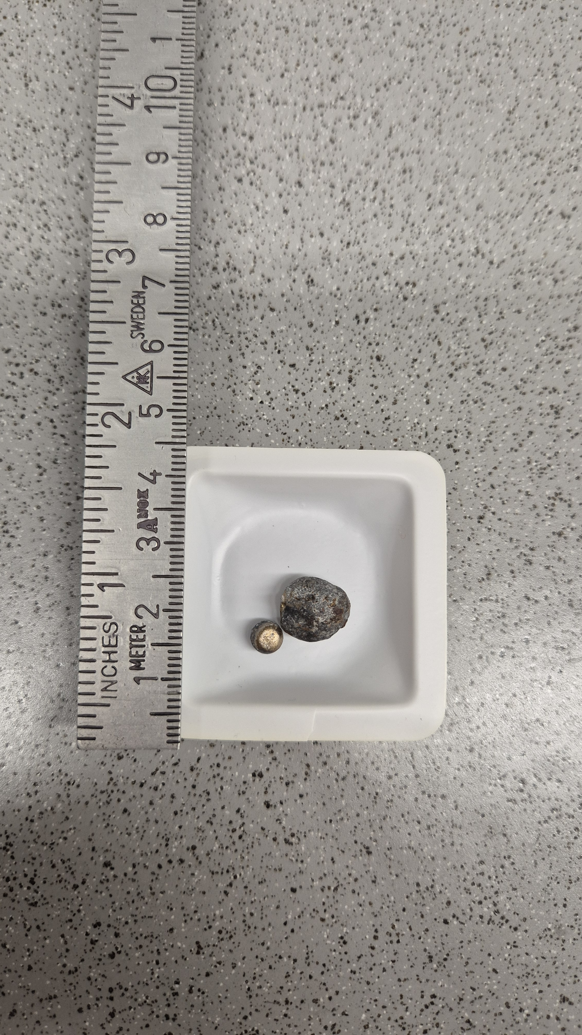
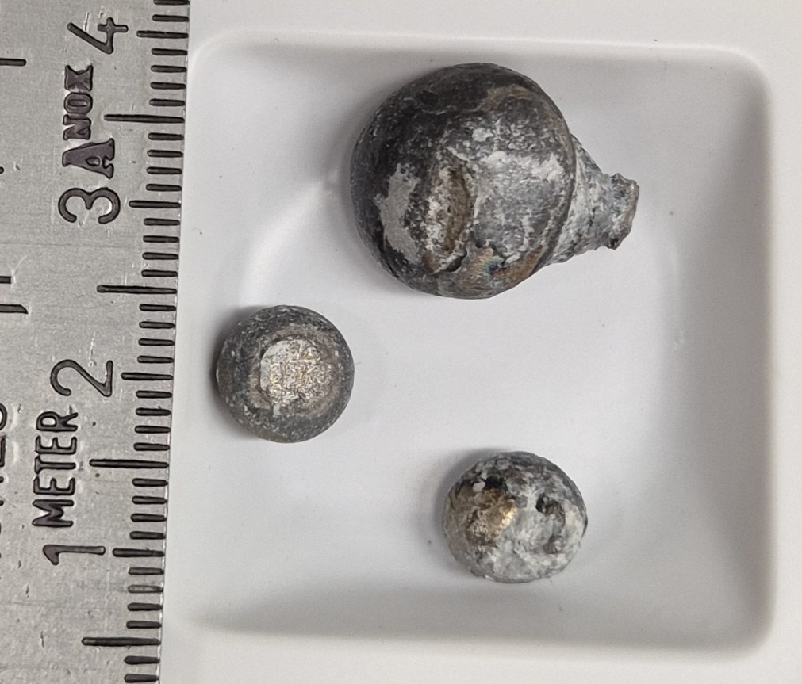
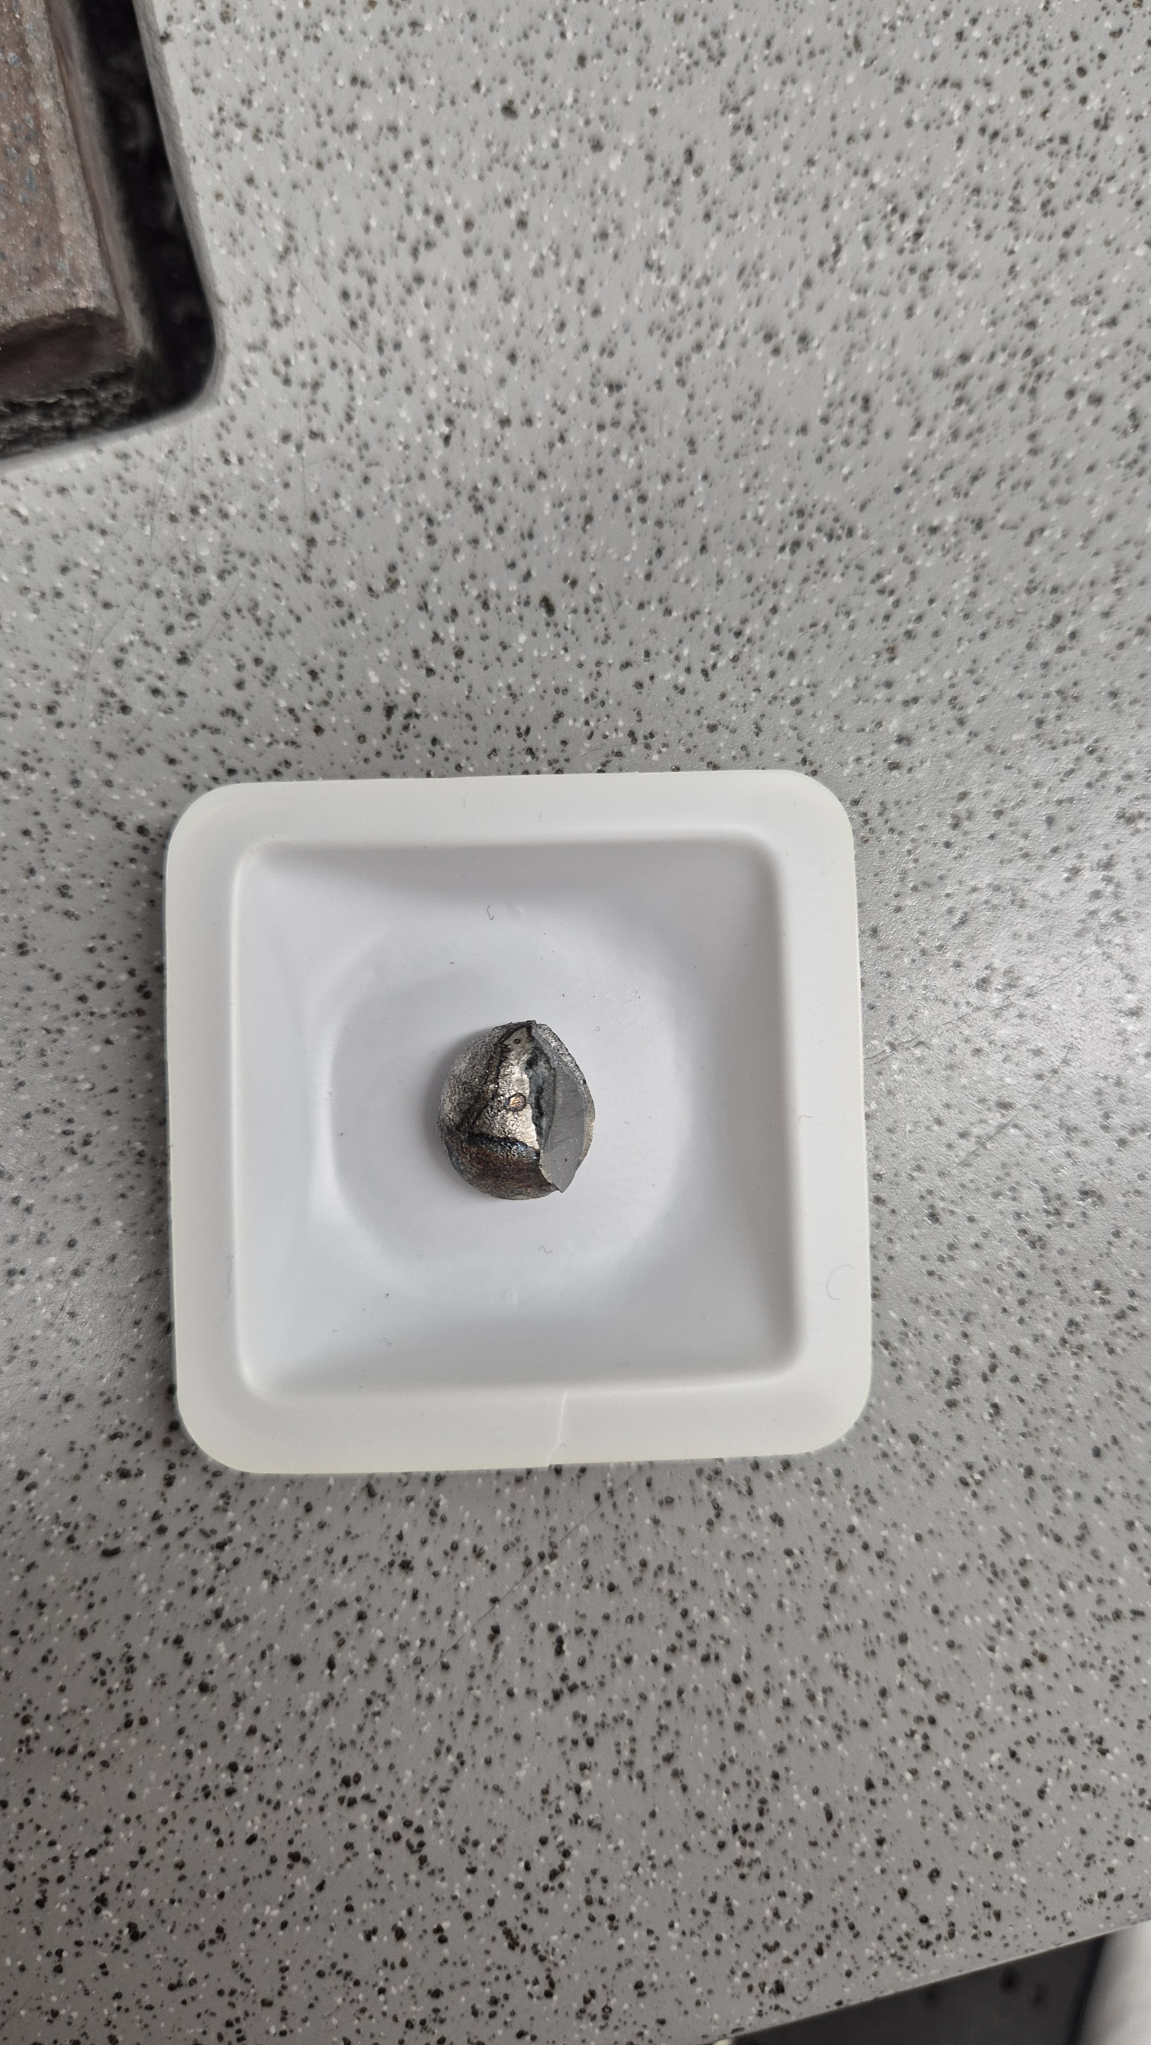
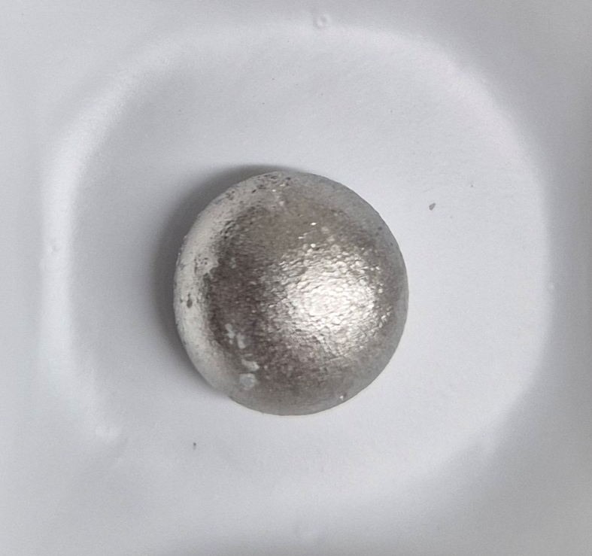
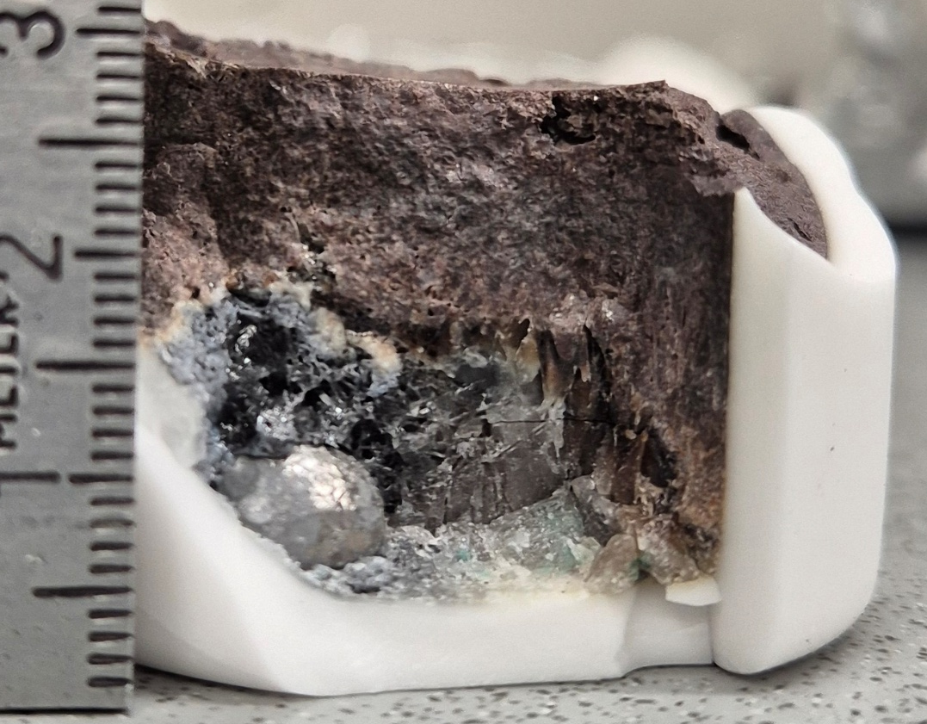
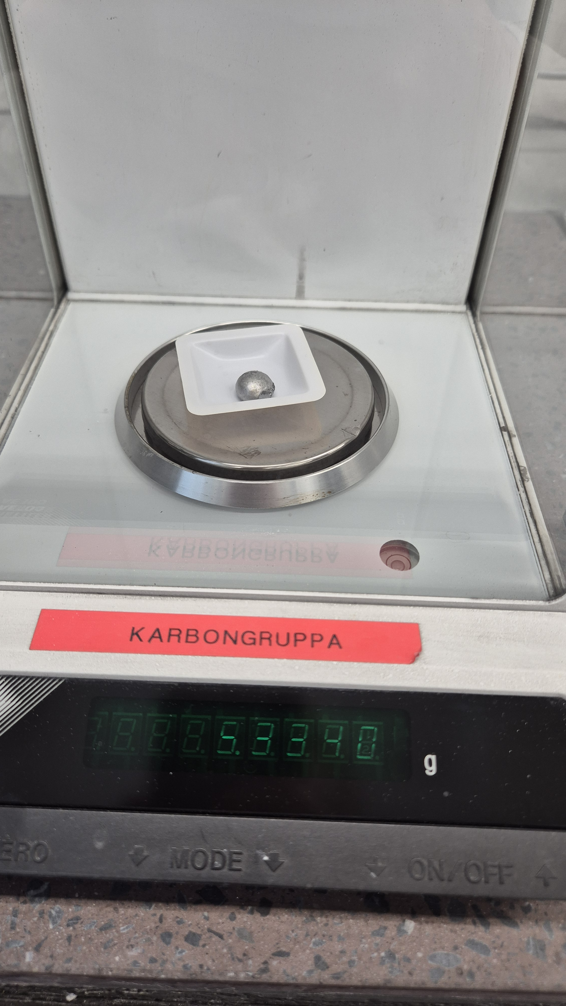
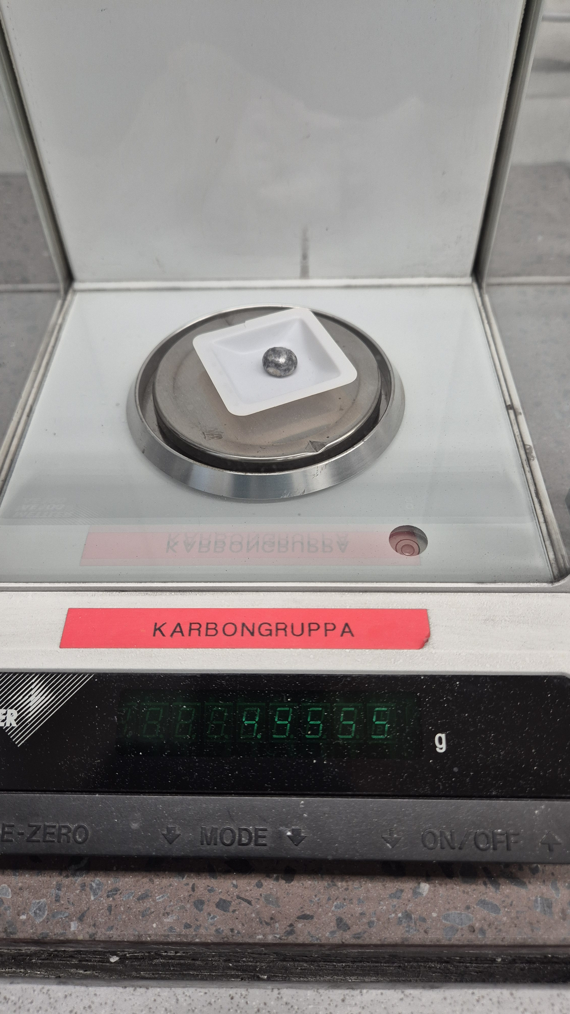
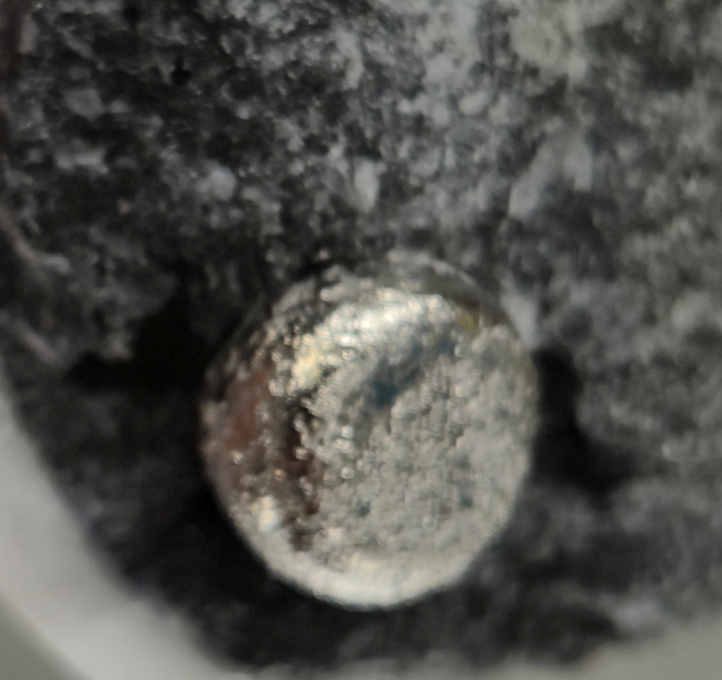
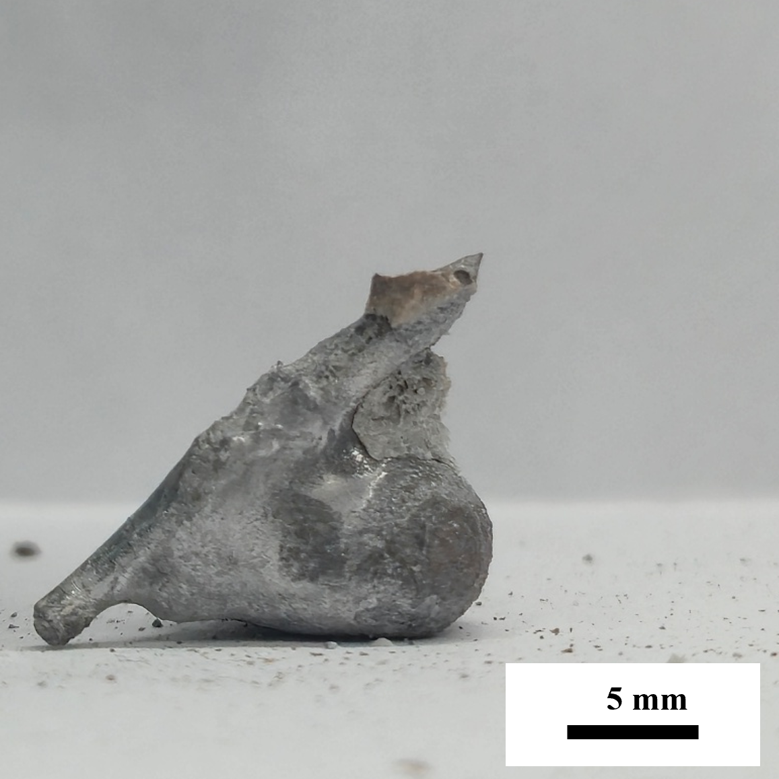
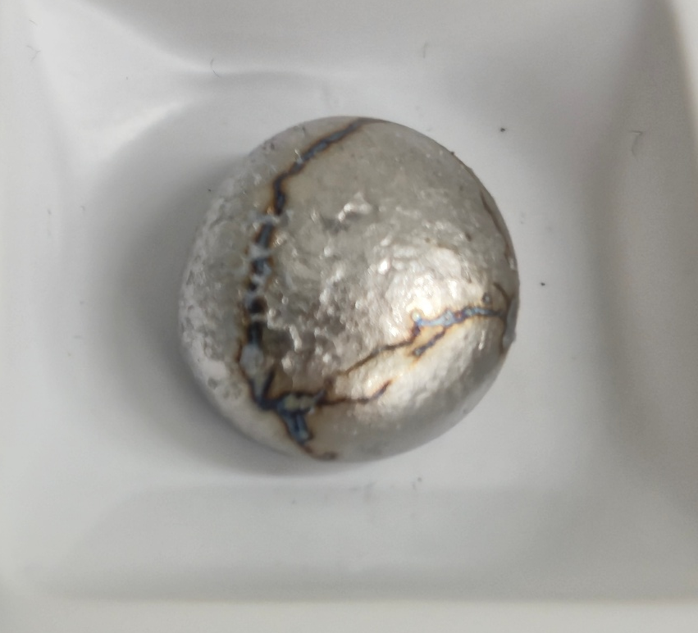
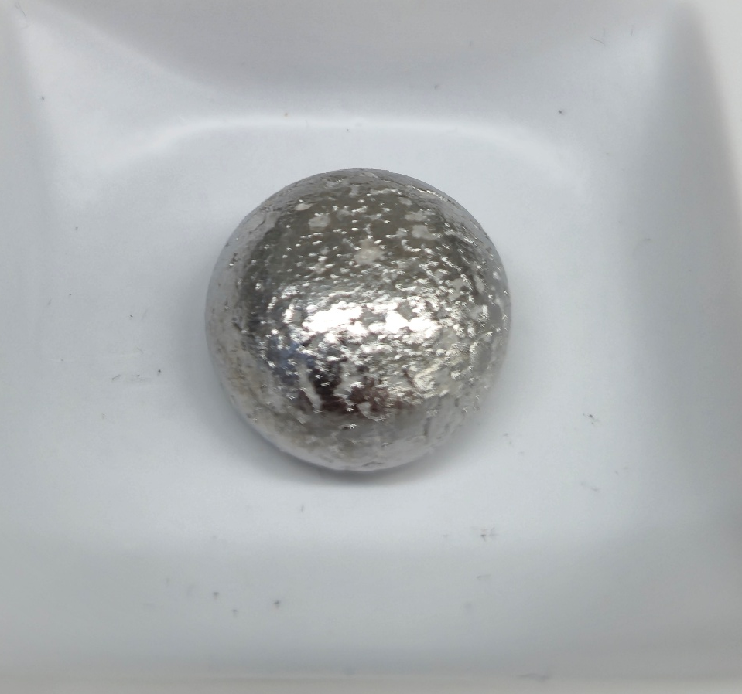

Slide 10
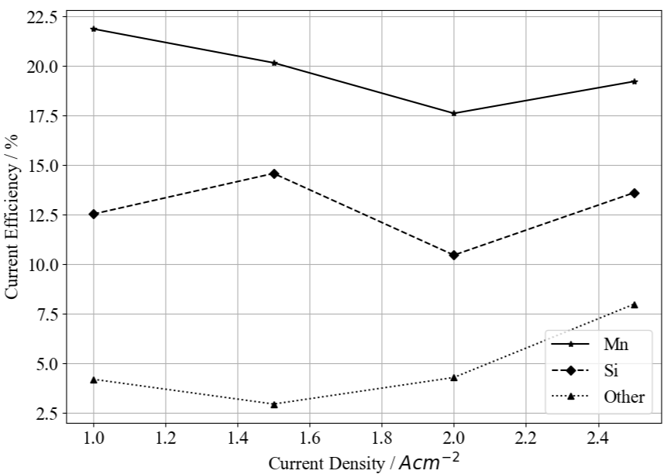
Results and Discussion – Current Density
Constant variables
Temperature | 1300ºC
Runtime | 4 h
[MnO] | 30 %
[SiO₂] | 40%
[CaO] | 14.1 %
[MgO] | 10%
[Al₂O₃] | 5.9%
Total Basicity | 1.105
Optical Basicity | 0.747
Viscosity [Pa s] | 0.540

Slide 11
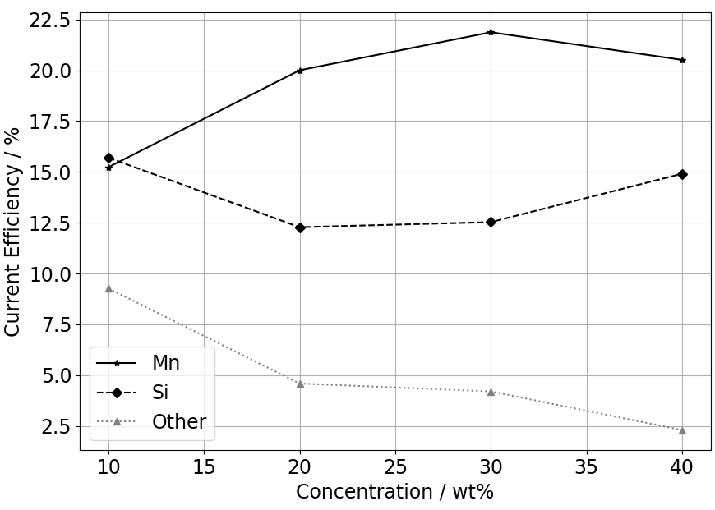
Results and Discussion – MnO Concentration
Constant variables
Temperature | 1300ºC
Runtime | 4 h
i_{cathodic} | 1 A cm⁻²
[SiO₂] | 40%
[MgO] | 10%
[Al₂O₃] | 5.9%
 | 10% | 20% | 30% | 40%
Optical Basicity | 0.747 | 0.747 | 0.747 | 0.747
Total Basicity | 1.007 | 1.056 | 1.105 | 1.155
Viscosity [Pa s] | 0.873 | 0.690 | 0.540 | 0.417

Slide 12
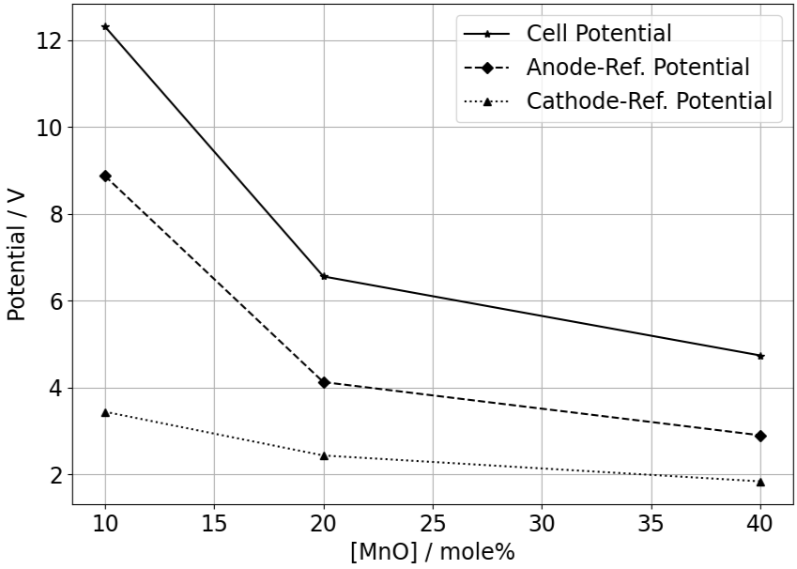
Results and Discussion – MnO Concentration
Constant variables
Temperature | 1300ºC
Runtime | 4 h
i_{cathodic} | 1 A cm⁻²
[SiO₂] | 40%
[MgO] | 10%
[Al₂O₃] | 5.9%
 | 10% | 20% | 30% | 40%
Optical Basicity | 0.747 | 0.747 | 0.747 | 0.747
Total Basicity | 1.007 | 1.056 | 1.105 | 1.155
Viscosity [Pa s] | 0.873 | 0.690 | 0.540 | 0.417

Slide 13
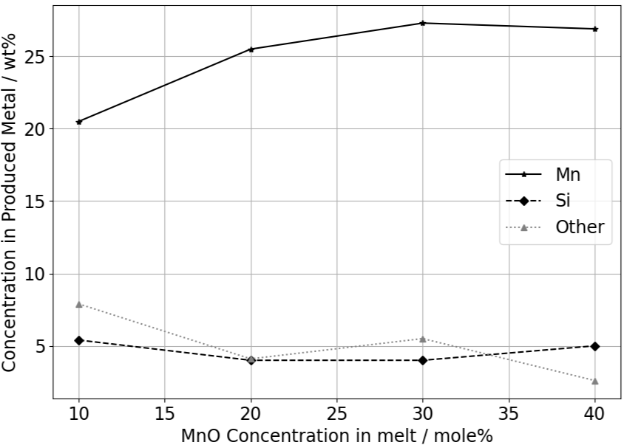
Results and Discussion – MnO Concentration
Constant variables
Temperature | 1300ºC
Runtime | 4 h
i_{cathodic} | 1 A cm⁻²
[SiO₂] | 40%
[MgO] | 10%
[Al₂O₃] | 5.9%
 | 10% | 20% | 30% | 40%
Optical Basicity | 0.747 | 0.747 | 0.747 | 0.747
Total Basicity | 1.007 | 1.056 | 1.105 | 1.155
Viscosity [Pa s] | 0.873 | 0.690 | 0.540 | 0.417

Slide 14
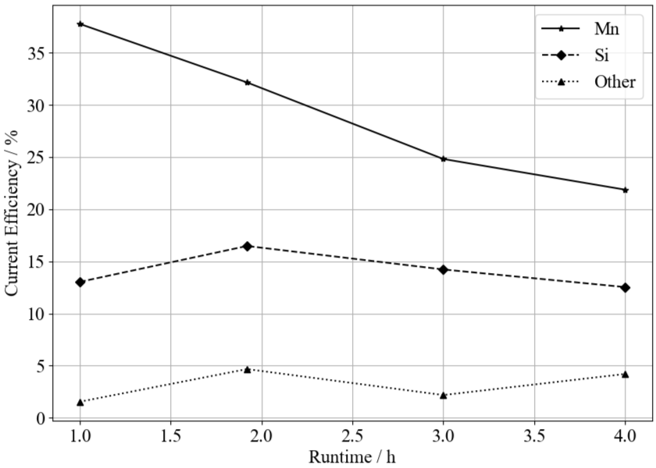
Results and Discussion – Runtime
Constant variables
Temperature | 1300ºC
i_{cathodic} | 1 A cm⁻²
[MnO] | 30 %
[SiO₂] | 40%
[CaO] | 14.1 %
[MgO] | 10%
[Al₂O₃] | 5.9%

Slide 15
Results and Discussion – Temperature
 | 1300ºC | 1350ºC | 1400ºC
Mn [wt%] | 27.3 | 21.0 | 13.1
Fe [wt%] | 63.4 | 72.8 | 81.1
Si [wt%] | 4.0 | 3.3 | 2.7
Other [wt%] | 5.3 | 2.9 | 3.1
Current efficiency | 1300ºC | 1350ºC | 1400ºC
Mn | 21.87% | 23.00% | 24.03%
Si | 12.53% | 14.14% | 19.37%
Other | 4.20% | 3.28% | 6.67%
 | 1300ºC | 1350ºC | 1400ºC
Viscosity [Pa s] | 0.540 | 0.396 | 0.296

Slide 16
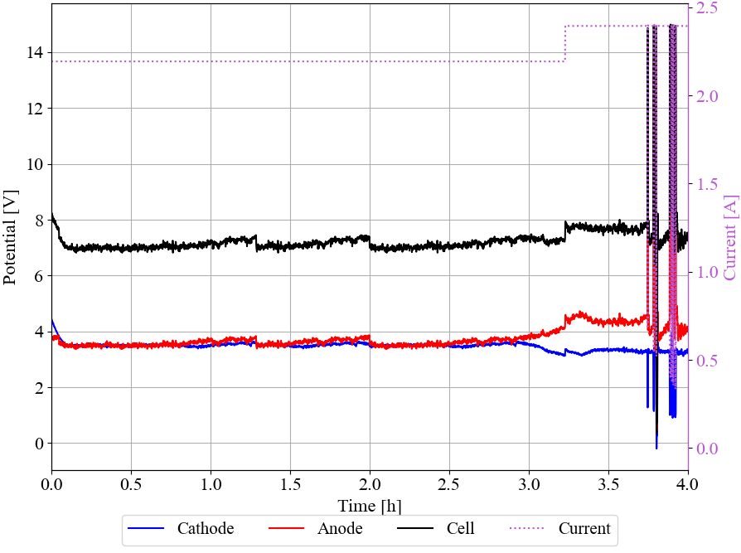
Results and Discussion – Co-Reduction
Temperature | 1300ºC
Runtime | 4 h
i_{cathodic} | 1 A cm⁻²
[MnO] | 29 %
[FeO] | 1%
[SiO₂] | 40%
[CaO] | 14.1 %
[MgO] | 10%
[Al₂O₃] | 5.9%

Slide 17
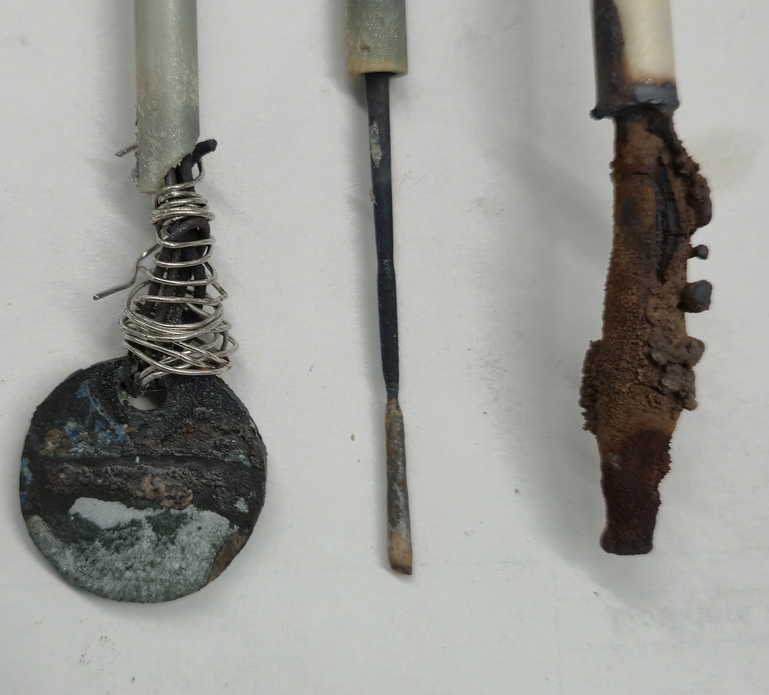
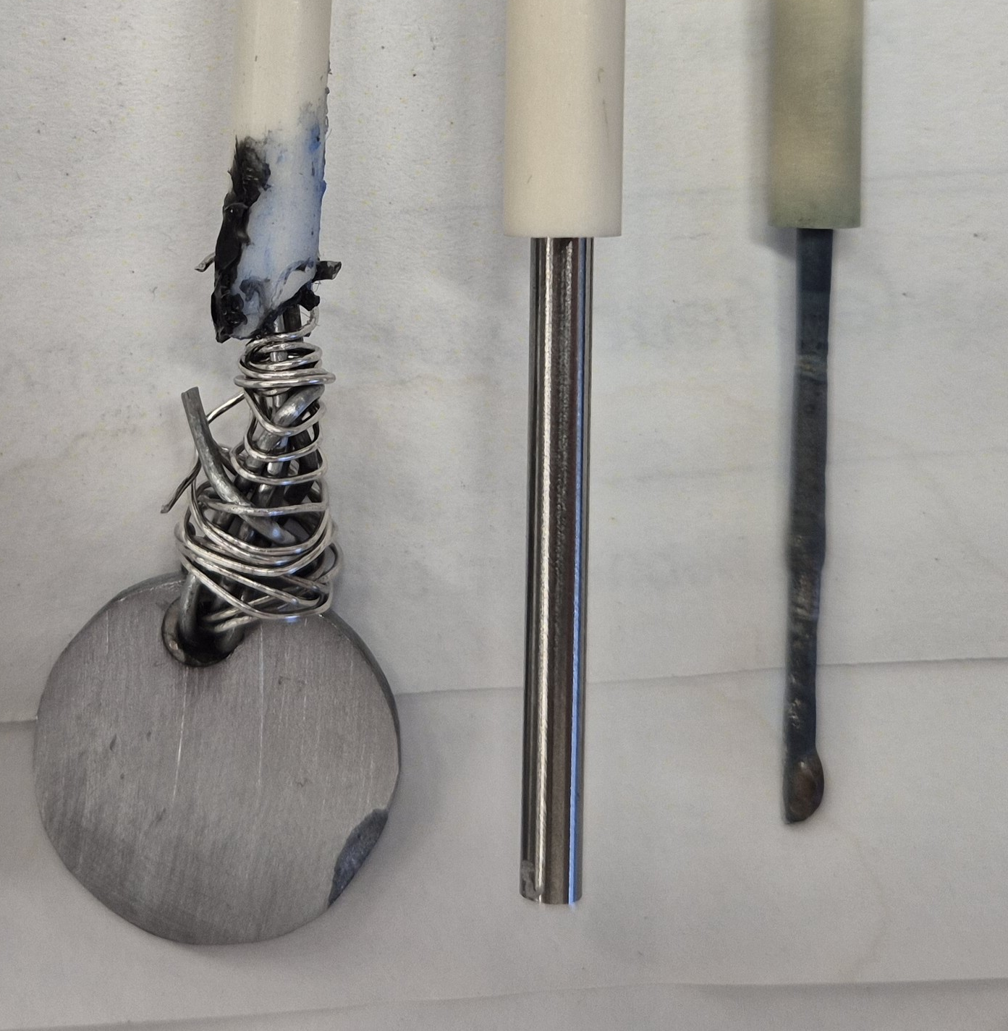
Results and Discussion – Co-Reduction
Temperature | 1300ºC
Runtime | 4 h
i_{cathodic} | 1 A cm⁻²
[MnO] | 29 %
[FeO] | 1%
[SiO₂] | 40%
[CaO] | 14.1 %
[MgO] | 10%
[Al₂O₃] | 5.9%
10 mm
10 mm
Anode
Cathode
QRE
Anode
QRE
Cathode

Slide 18
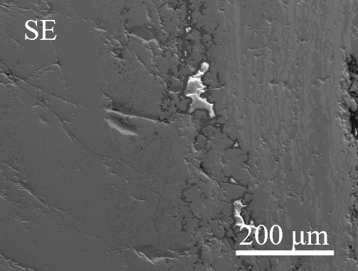
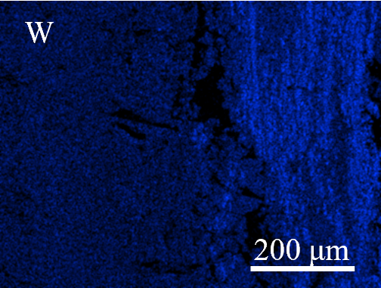
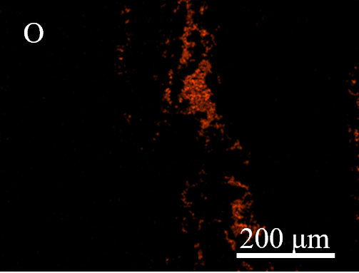
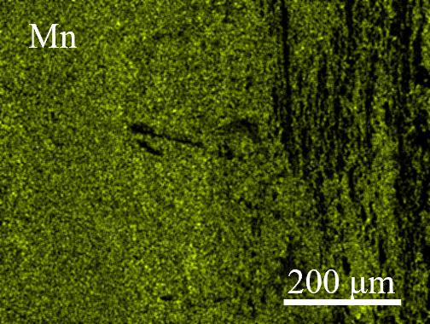
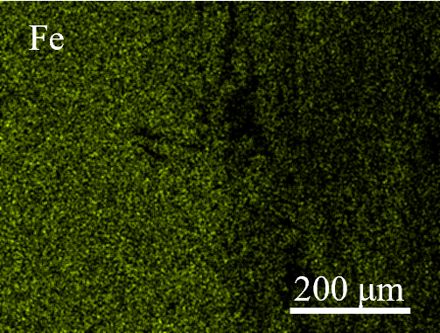
Results and Discussion – Co-Reduction
Temperature | 1300ºC
Runtime | 4 h
i_{cathodic} | 1 A cm⁻²
[MnO] | 29 %
[FeO] | 1%
[SiO₂] | 40%
[CaO] | 14.1 %
[MgO] | 10%
[Al₂O₃] | 5.9%

Slide 19
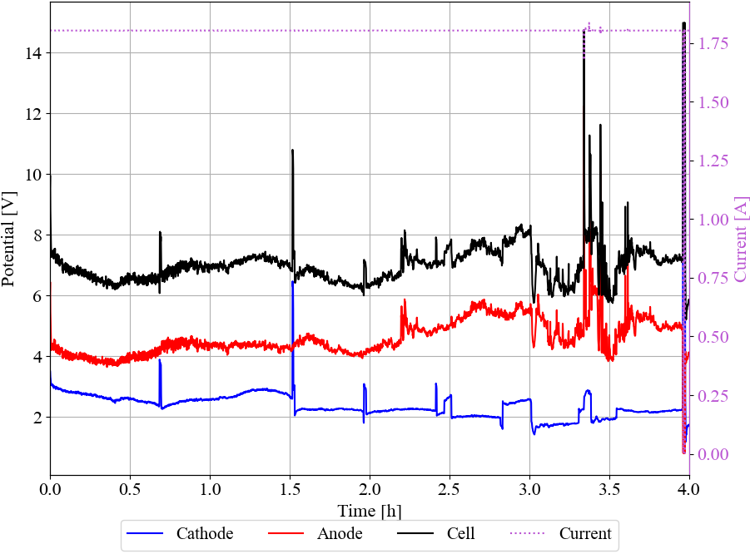
Results and Discussion – Synth.-Air Atmosphere
Temperature | 1300ºC
Runtime | 4 h
i_{cathodic} | 1 A cm⁻²
[MnO] | 30 %
[SiO₂] | 40%
[CaO] | 14.1 %
[MgO] | 10%
[Al₂O₃] | 5.9%

Slide 20
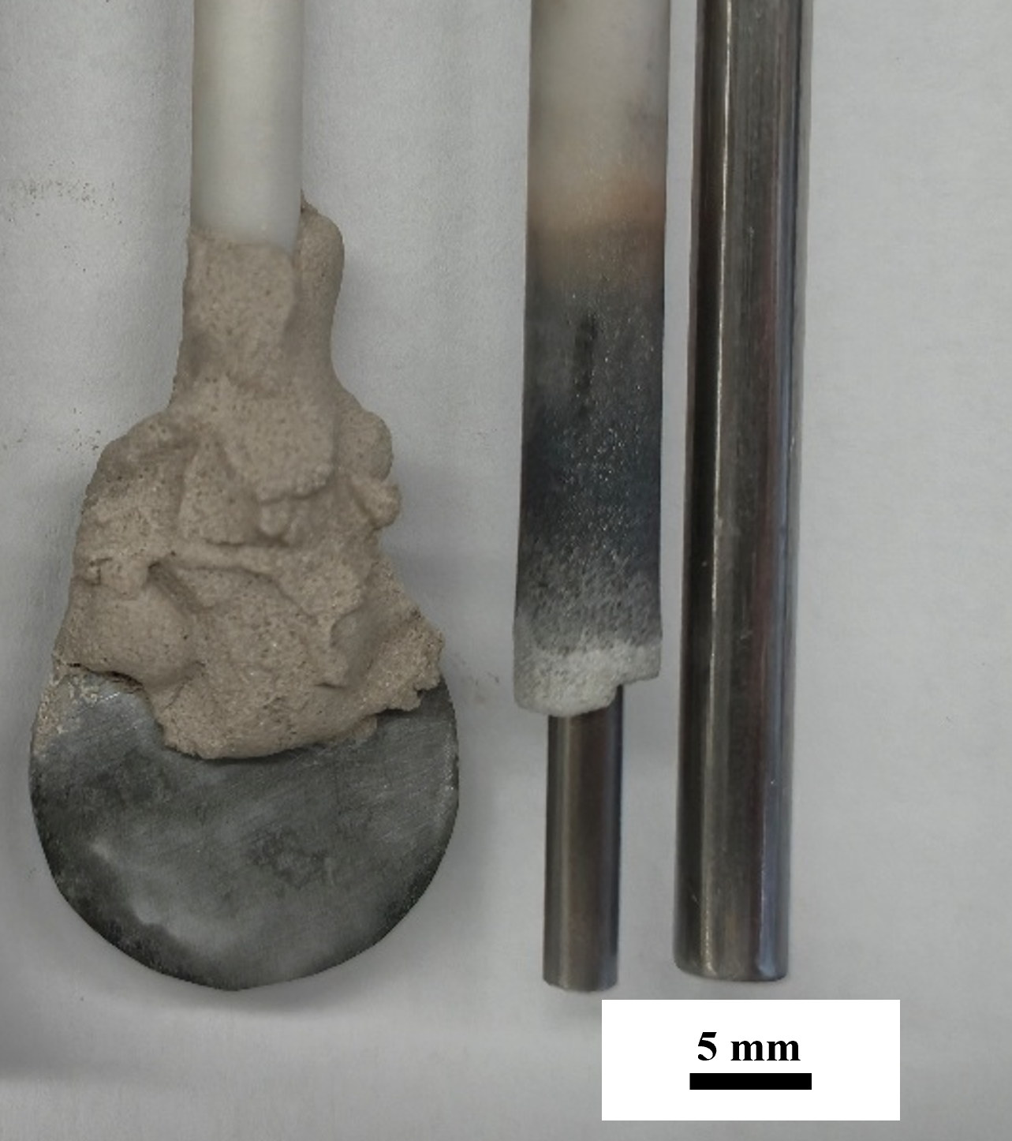
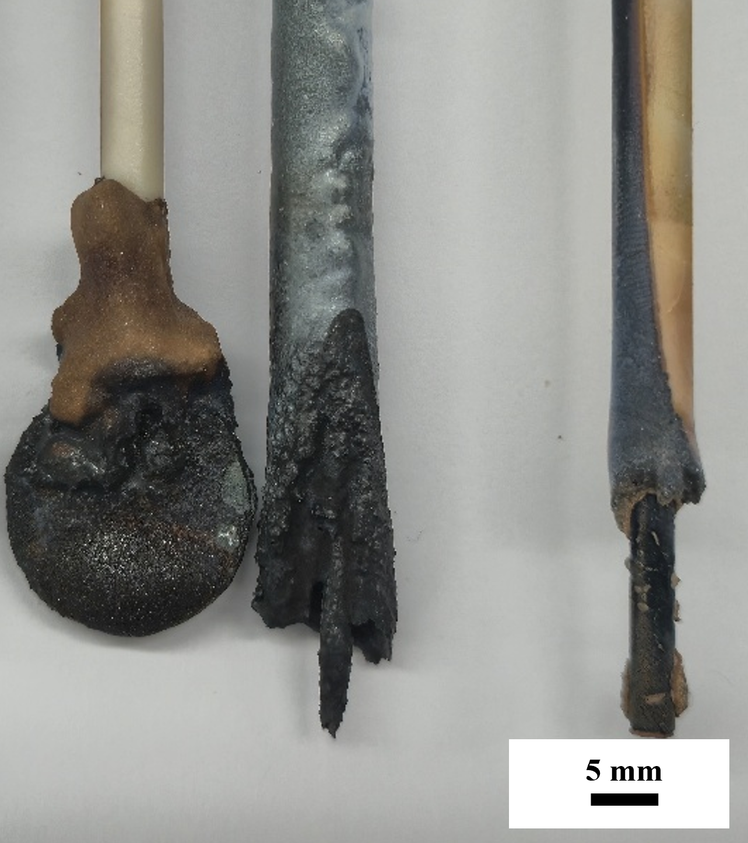
Results and Discussion – Synth.-Air Atmosphere
Temperature | 1300ºC
Runtime | 4 h
i_{cathodic} | 1 A cm⁻²
[MnO] | 30 %
[SiO₂] | 40 %
[CaO] | 14.1 %
[MgO] | 10%
[Al₂O₃] | 5.9%

Slide 21
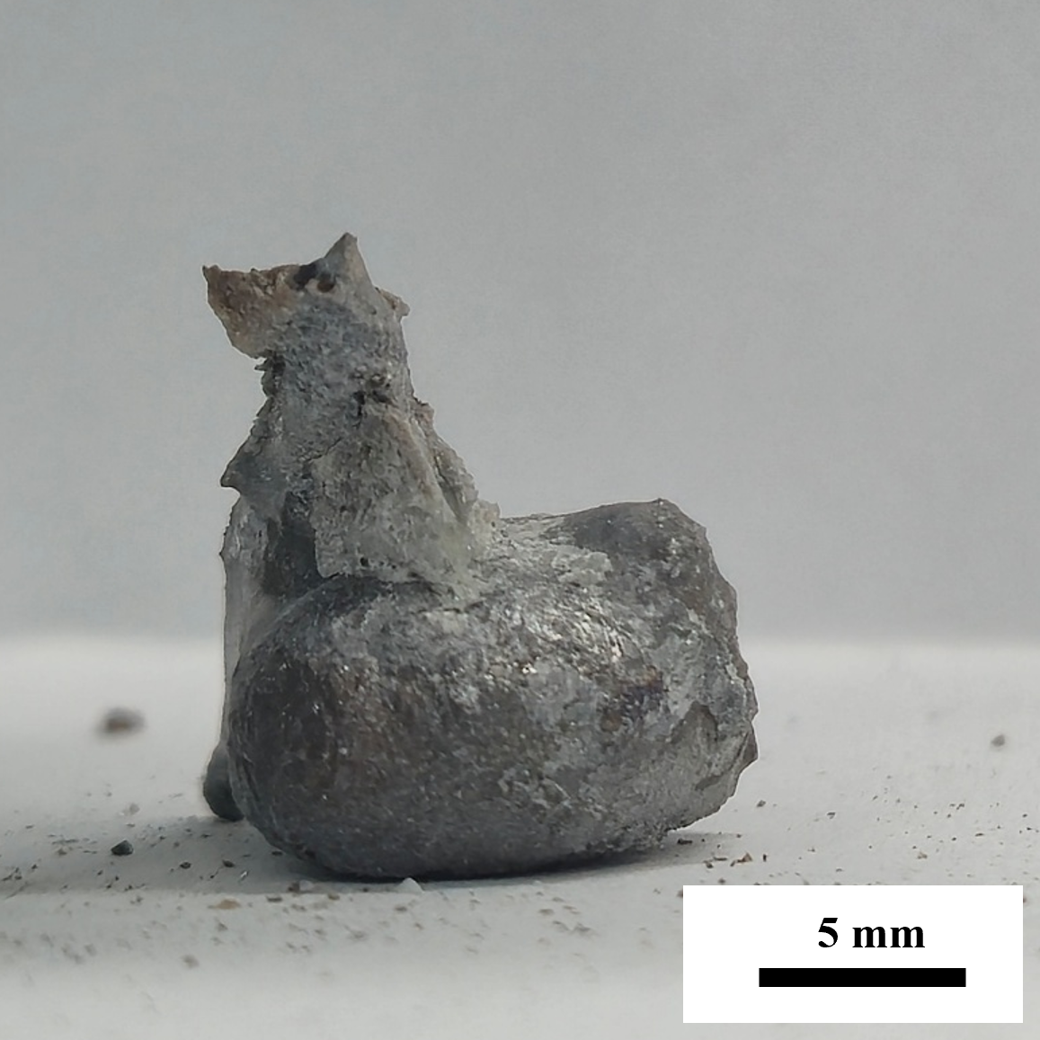
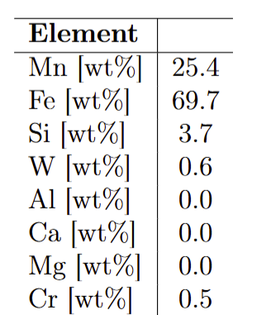
Results and Discussion – Synth.-Air Atmosphere
Temperature | 1300ºC
Runtime | 4 h
i_{cathodic} | 1 A cm⁻²
[MnO] | 30 %
[SiO₂] | 40%
[CaO] | 14.1 %
[MgO] | 10%
[Al₂O₃] | 5.9%
Current Efficiency
Mn | 28.42%
Si | 16.19%
Other | 1.39%
8.1g of metal (excluding cathode tip)

Slide 22
Conclusions
A cathodic current density of 1 A cm⁻² is indicated to perform best
MnO concentrations above 30 mole% results in little improvement
The atmosphere above the melt had no significant impact on performance.
Current efficiency reduces drastically with runtime
  Dissolution, reoxidation
Increasing temperature, improved electrochemical conditions, but resulted in high amounts of impurities.

Slide 23
Further Work

Slide 24


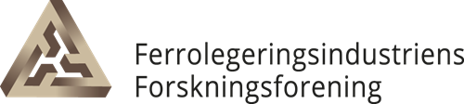




This Master’s Thesis is part of the ZeSiM project - Zero Emission Silicon and Manganese production through electrowinning, a joint project between NTNU and SINTEF. The project is funded by the Research Council of Norway (Grant No. 344259) and The Norwegian Ferroalloy Producers Research As-sociation (FFF) with its partner companies Eramet, Elkem, Finnfjord, and wacker, whose support is gratefully acknowledged.

